Slide 1
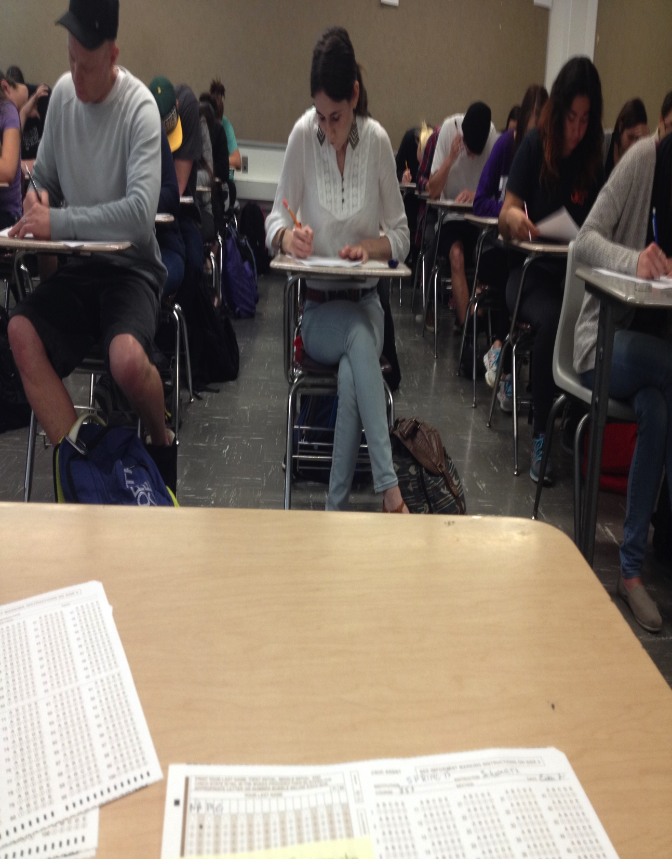
Exploring Representations Of Student Time-Use
Amy Rae Fox, MA, MEd Erica de Vries, PhD
Laurent Lima, PhD
Savannah Loker, MA, MEd
Notes:
GOOD MORNING everyone!
My name is Amy Fox, and I am a doctoral student in Cognitive Science at University of California – San Diego ☺
I work in information visualization, and I have a keen interest in external representations of time, space and number
Today I will be presenting on behalf of my co-authors, Drs. Erica de Vries et Laurent Lima from the Universite de Grenoble, and Savannah Loker, of California State – Chico.

Slide 2
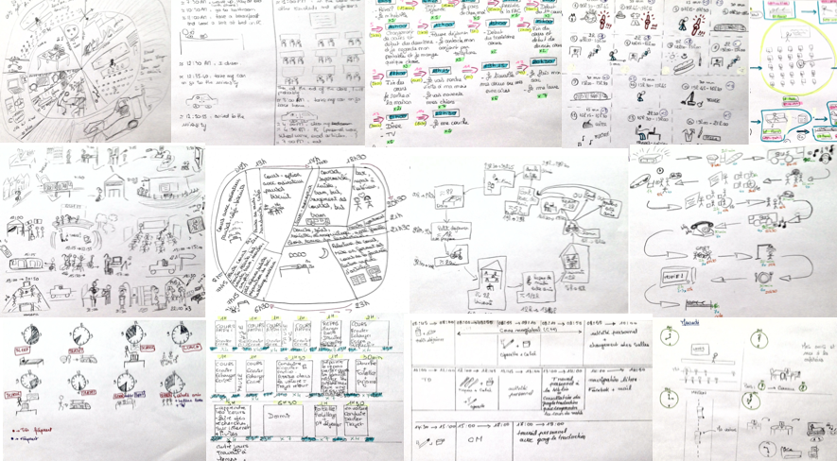
// scope
visual content analysis
student-produced representations
personal time-use
Notes:
The work that I am going to share with you today was a part of my Masters studies in cognitive visualization.
While in Grenoble In the spring of 2014 I undertook a number of activities with a group of undergraduates a public French university
One of which resulted in this exploratory study – a visual content analysis of representations students produced describing their personal time-use.

Slide 3




// motivation
How do students think about managing their time?
(Fernex, Lima & de Vries, 2014)
Notes:
This project was inspired by a larger research effort by the learning sciences group in Grenoble investigating the relationship between a university student’s academic success, and how they choose to allocate their time.
We know that our students need to balance their time between competing demands of academics, socialization, physical and mental health. The decisions that they make during this time have profound implications for their academic and professional success
In their 2014 analysis addressing high rates of failure, and redoublé rates at the Bachelor level at french institutions, Fernex, Lima and De Vries concluded that the choices students make with respect to their time were more often rooted in their past and present experience than their goals and expectations for the future.
This raises the question the question of awareness, and the extent to which students are actively thinking about how they spend their time, actively making decisions about time allocation.
While I was in France, I partnered with Alain Fernex and Laurent Lima to explore this question in the classroom, with a group of undergraduates in a skills development course.

Slide 4




// time-use data
Activity
Duration
Timing
Sequence
Frequency
{ Quantity of time }
{ Temporal location }
{ Order of Activities }
{ Quantity of occurrences }
Notes:
When I use the term ‘time-use’ I am referring to more than just the activities that a student performs, but also four temporal components
first – duration- or the quantity of time spent on a particular activities. This is where much research in the time-use community is situated, often comparing the duration of time spent on particular activities as a function of age, gender, geographic location or socioeconomic status.
But as we are ultimately interested in students productivity, we are also interested in the timing – the clock time - or temporal location of their activities. Do they study at 9 am, or 9pm?
We are interested in the sequence – or relative order of activities. Do I go to the gym before doing my homework, or afterward?
And finally – frequency – or the number of occurrences of an activity in a given interval of time. How many times do I check my email over the course of a day, or perhaps even during this class session

Slide 5

// conceptual framework
visualizing thought
use of space
use of form
a
(Tversky, 2011)
Notes:
As a cognitive scientist, I’m not only interested what a student’s representation of their time use can tell me about their awareness of time,
but also what these representations might reveal more generally about conceptualizations of time and the relationship between externalized graphics and internal representations of thought.
We chose Barbara Tversky’s 2011 review paper Visualizing Thought as our conceptual framework for evaluating the content and structure of the representations the students would produce
Following this vocabulary, we decided to catalogue how the students used space and form in their diagrams, and to look for correspondence with the existing literature on external representations of time

Slide 6
?
// research questions
How do students use space and form to represent time-use?
What mechanisms are used to represent each component? { sequence, timing, duration & frequency }
Notes:
We set out to address two research questions:
first, how do students use space and form to represent time-use
secondly, what mechanisms (particular uses of space and form) do students employ to represent each component of time-use? [duration, timing, sequence and frequency]

Slide 7
visual content analysis {directed approach}
// method
develop categories
aligned with research questions
structured by (Tversky, 2011)
gather content
diagramming activity
iterate coding scheme
rate
assess reliability
(space) α = 0.876 (form) α = 1.000 (mechanisms) α = 0.972
(Hsieh & Shannon, 2005)
Notes:
We chose a directed approach to visual content analysis for this initial exploratory work because we wanted to produce a coding scheme that was informed by the existing literature as well as evidence present in the sample.
First we developed the categories of the coding scheme based on our research questions using the vocabulary offered by Tversky, 2011.
Then we gathered our content by engaging the students in the diagramming activity
We then applied the coding scheme to a subset of the diagrams in an inductive process were we collapsed categories that were present in the sample, added others and developed strict operational definitions for each category.
We then had three raters independently code the entire sample and assessed the ratings for interrater reliability. The resulting Krippendorf’s alpha scores for each area of the coding scheme exceeded the recommended threshold of 80% agreement.
Our final data set was constructed from the individual raters results (based on the majority rating) which was then used for our data analysis.

Slide 8


// participants
n = 25 (22 f, 3 m) Median = 23
Notes:
Our students were 25 undergraduates enrolled in graduate studies preparation course. You may be unsurprised to hear that 22 were female, 3 male, and the median age was 23. They were all native French speakers and enrolled in the diploma in Education at the university.

Slide 9
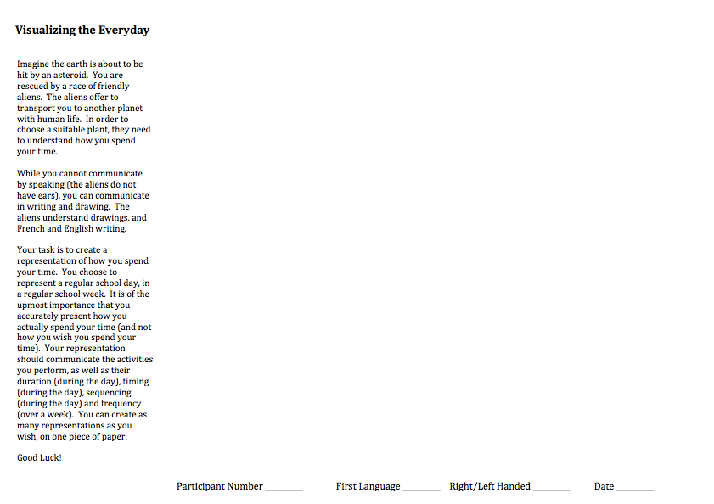


// materials & procedure
Notes:
On the day of the activity, completed a short demographic survey and were given sheets of paper containing the visualization scenario.
Although their participation was a requirement of their academic course, we wanted to motivate students to expend cognitive and creative effort on the activity.
So we developed a playful scenario in which the students are being rescued from a doomed planet earth by a race of friendly aliens. Their successful resettlement on an appropriate planet is dependent on the student accurately communicating how they spend their time over the course of an average week during the academic year. The were also told that the resulting representations would be used in the subsequent class activities.
The scenario explicitly called for representation of five components: activity (what), duration (quantity), timing (chronological point in time), sequence (order) and frequency (number of times).
They were instructed to create as many representations as necessary, using any graphic conventions desired. The text was carefully worded to use only the term “representation” when referring to the graphic output, avoiding a bias in visual forms with words such as: chart, graph, picture, sketch, icon, or text.
The students were given one sheet of A4 paper, and had access to their own pens, pencils and colored highlighters.

Slide 10
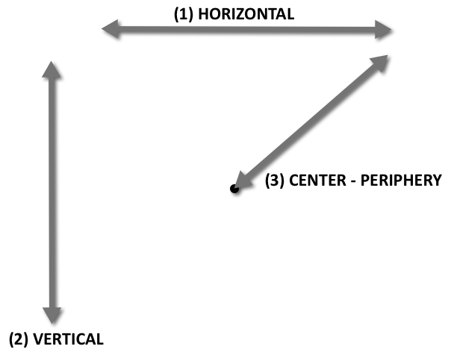
// coding – space
(4) CW - CCW
(4) CW - CCW
Notes:
I’m going to continue by discussing our coding scheme in conjunction with our results, as the coding scheme is in and of itself one of the results of the work
We first analyzed the diagrams for their use of space.
We determined if the Gestalt use of space was primarily linear: indicating a start and an end or circular – suggestive of a cyclical relationship between activites.
Then we evaluated the direction of the flow of information.
We evaluated the use of in horizontal and vertical axes, as well as
For circular representations, we evaluated the direction along the circumference, and along the radius.

Slide 11
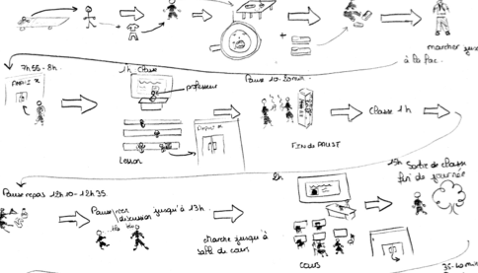
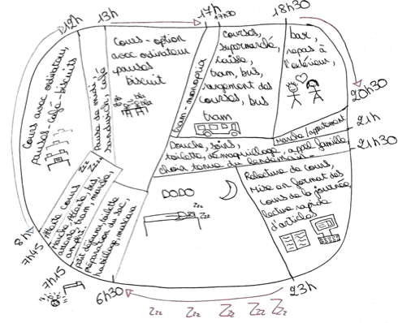
// results
{ gestalt use of space }
Notes:
Of the 25 diagrams, Twenty-one diagrams were characterized as linear and four as circular.

Slide 12
// results
{ space - start of day }
20
2
2
1
Notes:
Nearly all of the students (22) depicted the start of the day in the upper left corner of the page, in accordance with reading and writing conventions
Two students placing the start of the day at the 12:00 position of a clock, and one was linear, starting in the lower left corner.

Slide 13
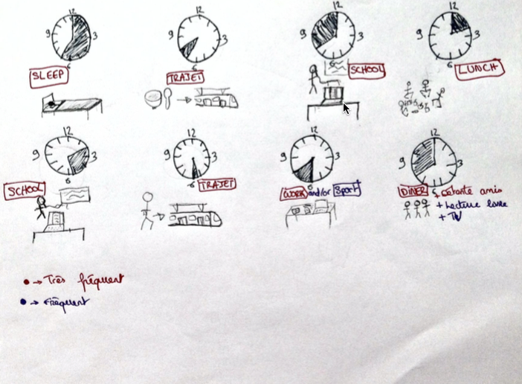
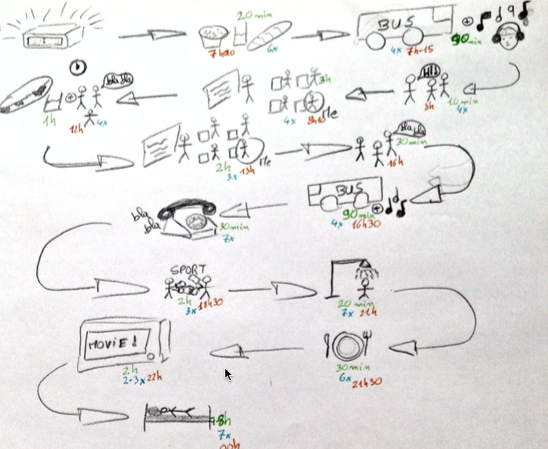
// results
{ space – linear direction}
left-to-right
“snake”
Notes:
Of the subset (21 linear diagrams) …
Sixteen adopted a left-to-right orientation, while four alternated directions in a snake-like pattern.
We noticed that 3 of the 4 snake representations used arrows to explicitly indicate the change in direction, while most of the left-to-right diagrams did not – rather relying on the convention of reading direction to assume the viewer will skip to the next line and continue reading left-to-right, without the need to provide a formal indicator of direction.

Slide 14
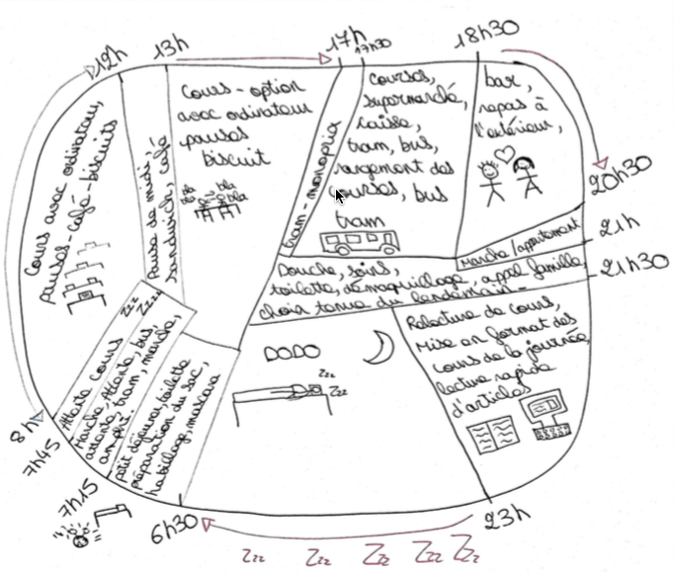
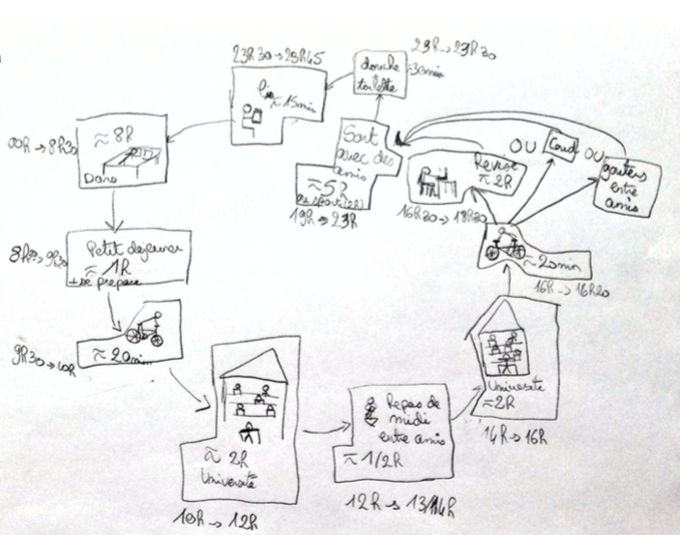
// results
{ space – circular direction}
clockwise
counter-clockwise
Notes:
Of the four circular diagrams, three presented information in the clockwise direction and only one in a CCW fashion.
There was minimal use of the radial orientation, with only two diagrams depicting flow from the periphery of the circles toward the center in a spiral fashion when they seemed to run out of space along the perimeter of the form.

Slide 15


// coding – form
(1) TEXT
Et puis je prends un petit verre…
(2) NUMBER
12pm - 4 am; 2 x
(3) ARROW
(4) DEPICTION
(5) COLOR
Notes:
Next we moved on to the use of form – marks on the page.
After our iterative coding process we were left with 5 categories of form: text,
number – which we differentiated from text as employing numeral forms w/ unit indicators
arrows
pictorial depictions
and use of color

Slide 16
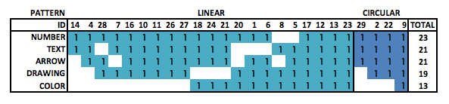
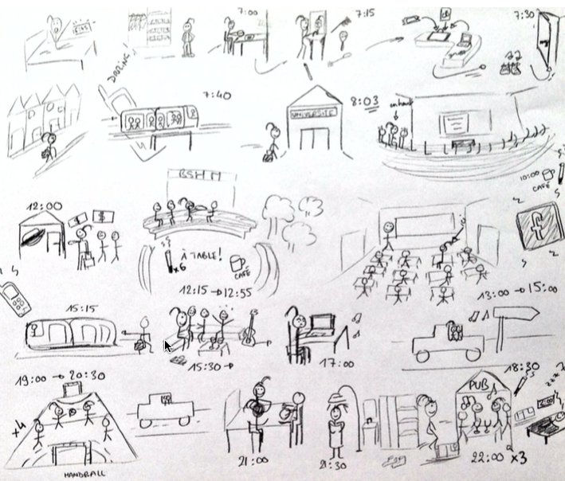
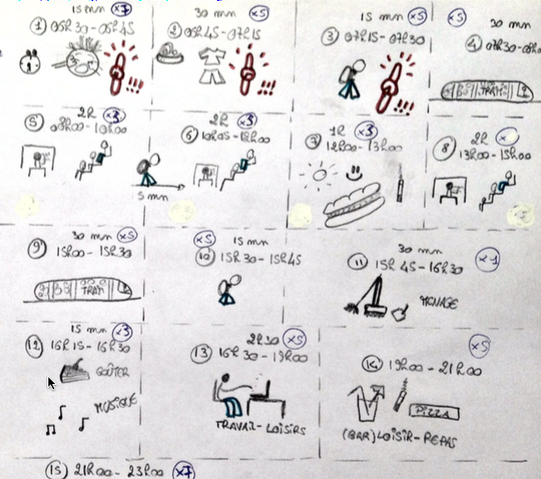
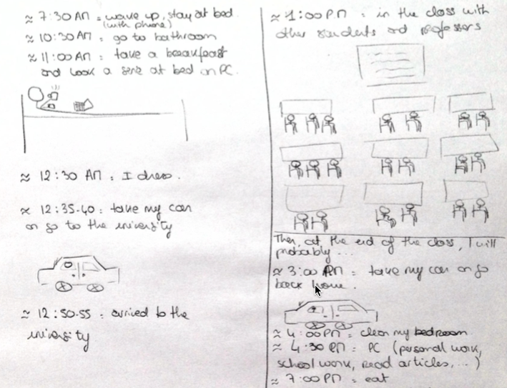
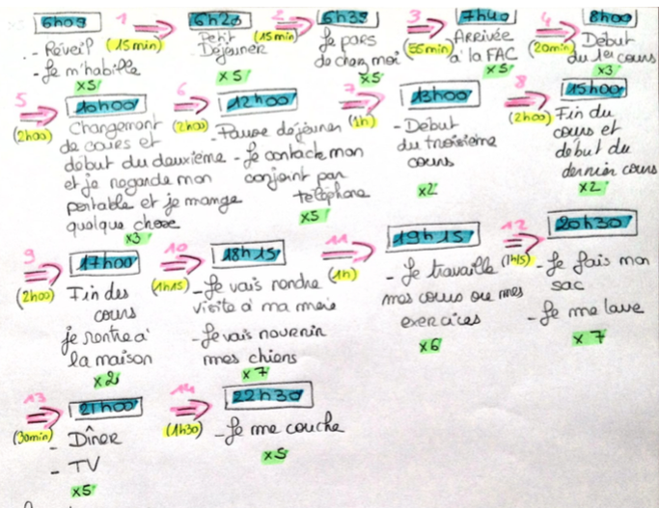
// results
{ use of form}
highly depictive - - - - - - - - - - - - - - - - - - - - - - - - - - - - - - - - -
highly descriptive
Notes:
The use of form in the sample was varied, suggesting the scenario was effective in motivating students without biasing their choice of form.
Number was the most prevalent form, found in 23 of the 25 diagrams, followed by text (21).
Nineteen included depictive drawings, while only 13 utilized more than one color.
Figures 4 - 6 exemplify the range of forms in the drawings from highly depictive (employing analogs) to highly descriptive (employing symbols). As evident in these examples, the use of descriptive vs. depictive drawings to describe activities fell on a continuum. There were no examples of prevalent but poorly executed drawings, suggesting that students utilized forms in accordance with their drawing ability.

Slide 17
// coding – primary mechanisms
Activity
Duration
Timing
Sequence
Frequency
{ Quantity of time }
{ Temporal location }
{ Order of Activities }
{ Number of occurrences }
Notes:
For primary mechanisms, we noted whether or not each component was indicated in the representation, and if so, which mechanisms of form and use of space were employed
Where possible, we differentiated between primary and supporting mechanisms, such as the presence of both pictures with a text label to describe an activity.

Slide 18
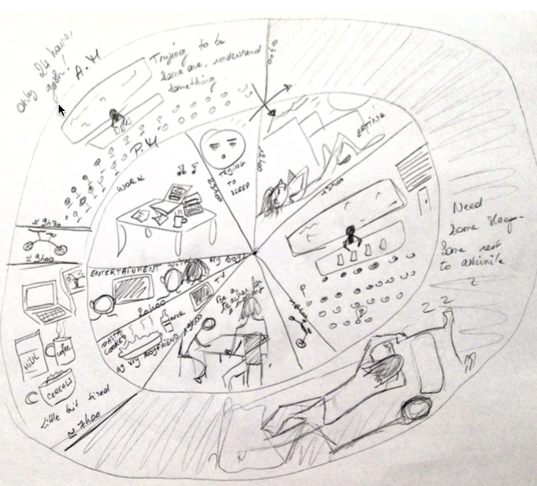
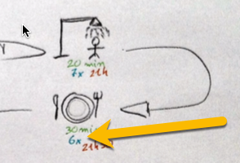
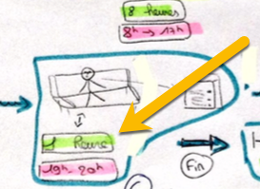
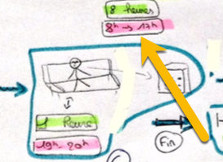
// results
{ primary mechanisms }
Duration
Timing
Sequence
Frequency
Notes:
Only four individuals effectively represented all five components.
Duration was often absent from the drawings, but when it was present, it was indicated by number.
Timing was almost exclusively represented by number.
Sequence was always indicated by relative spatial position, in many cases with the addition of arrows.
Frequency was most commonly neglected,
….followed by duration, then timing.
Two imaginative illustrations also utilized position to indicate timing by placing drawings around the corresponding positions of a clock face to indicate the time of day they began.

Slide 19
// observations
SPACE
Consistent w/ external spatial representations of time
Preference for linear over circular
FORM
Absence of meaningful glyphs other than arrows
MECHANISMS
Exclusively spatial-position to represent sequence
Spectrum of pictures --- text for activities
Number for timing
Duration & Frequency generally neglected
GENERAL
Difficult to represent all components in 1 diagram
Preference for single integrated diagram
No statistical charts or graphics
~ Resemblance to agendas and calendars

Slide 20
// future directions
Student Intervention
bring awareness to the (diagrammatically neglected) duration & frequency
Scale
differentiating communicative purpose
samples w/ differing domain knowledge
cross-cultural
Diversify
correlation with time planning & management tools
representations of multi-tasking
time-course of construction
Notes:
limitations: While there are many purposes for external representation (i.e. persuasion, problem solving, exposition, planning) the scenario was constructed to prompt graphic productions in the most general case: informative communication.

Slide 21




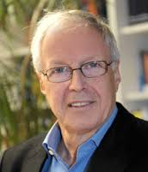
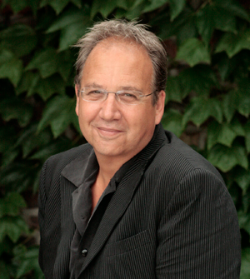



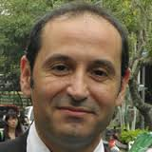

// thank you
Fernex, A., Lima, L., de Vries, E.: Exploring time allocation for academic activities by university students in France. Higher Education pp. 1–22 (2014)
Tversky, B. (2011). Visualizing Thought. Topics in Cognitive Science, 3(3), 499–535. doi:10.1111/j.1756-8765.2010.01113.x
Hsieh, H.-F. & Shannon, S. E. (2005). Three approaches to qualitative content analysis. Qualitative Health Research, 15, 1277-1288.

